Slide 1
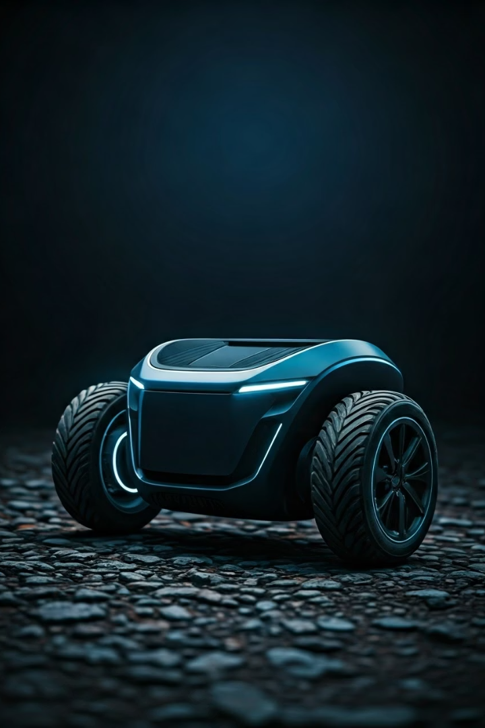
Self-Balancing and Traction Vehicle
Presented by Mukul, Arvind, Neelesh, Gokul, Hima, Bhanu

Slide 2
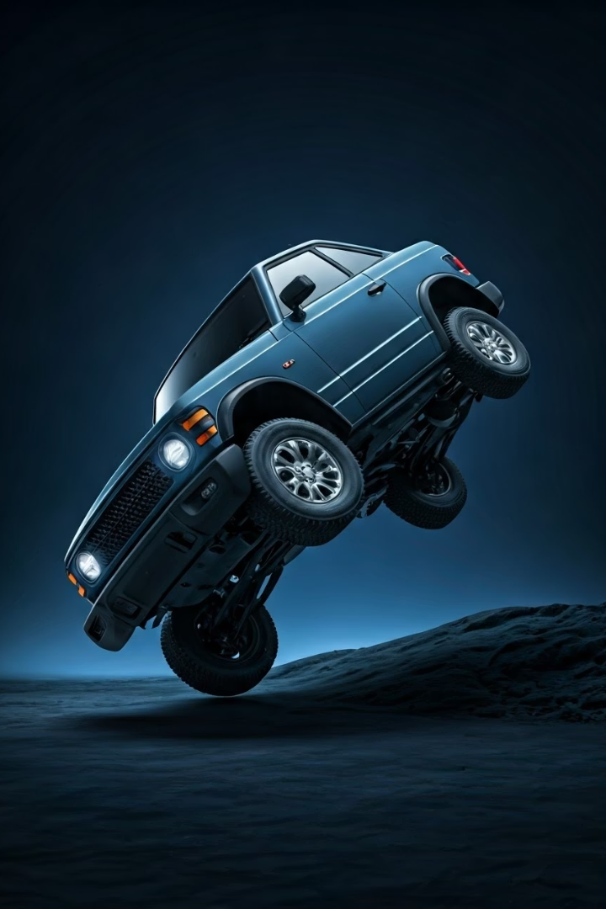
Problem Statement
Stability Issues
Small vehicles often fall on uneven ground or when pushed.
Movement Challenge
Difficult to balance while moving forward or backward.
Real-World Impact
Safety and performance concerns in transport and delivery robots.
Goal
Build a self-balancing vehicle with stable forward and backward motion.

Slide 3
Our Solution
Sensor Input
Motor Control
MPU6050 measures tilt angle continuously.
Motors adjust wheel rotation to correct balance.
Arduino calculates lean angle for control.
3D CAD design guided prototype construction.

Slide 4
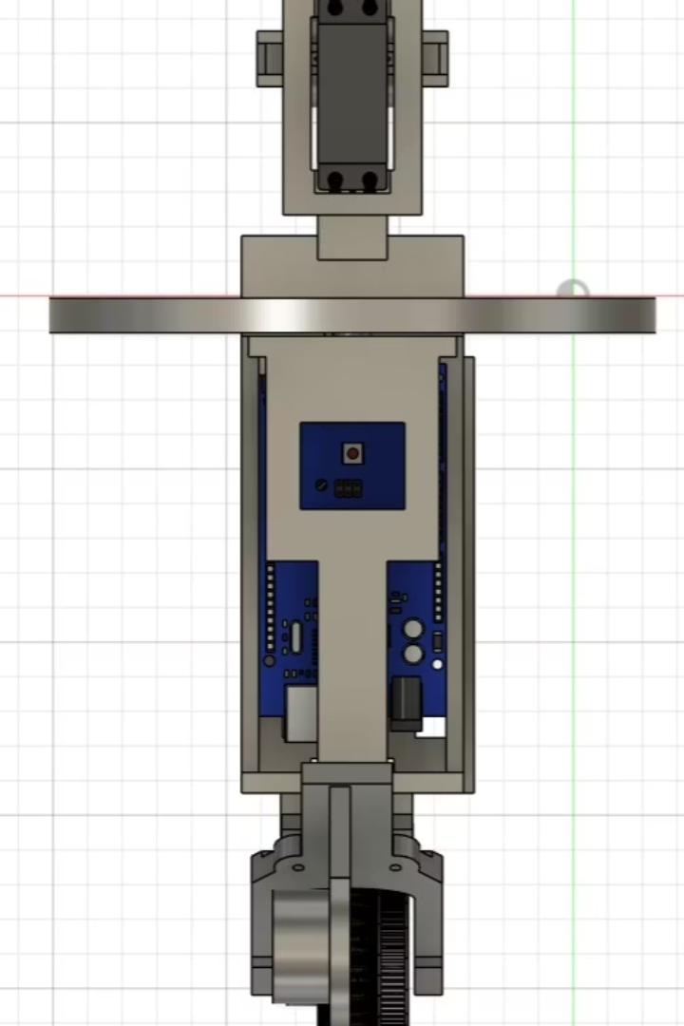
CAD Design Overview
Top Layer
Battery placement for balanced weight distribution.
Middle Layer
Arduino and motor driver board secured here.
Bottom Layer
Wiring and switches organized for safety.

Slide 5
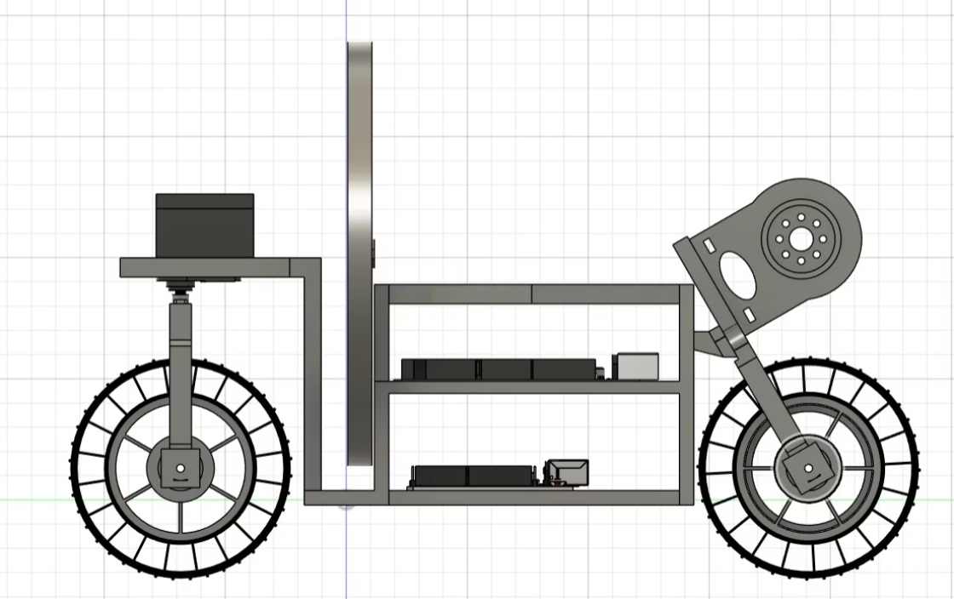
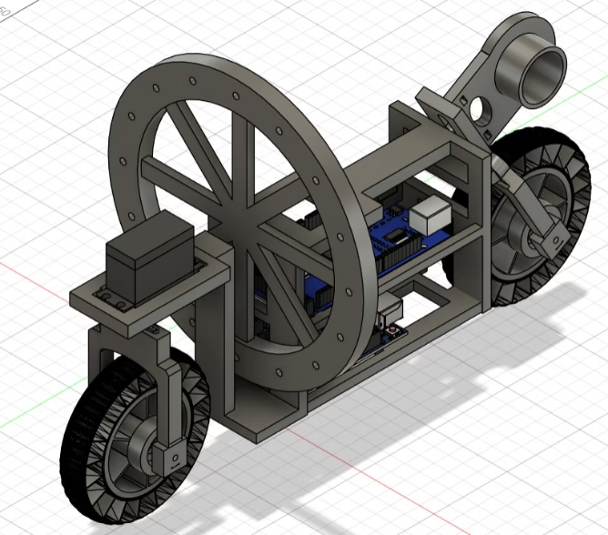

Slide 6
Real Model vs CAD
Accurate Build
Component Placement
Neat Wiring
Prototype matches CAD design closely.
Arduino, MPU6050, motors positioned carefully.
Wires arranged to prevent shorts and interference.

Slide 7
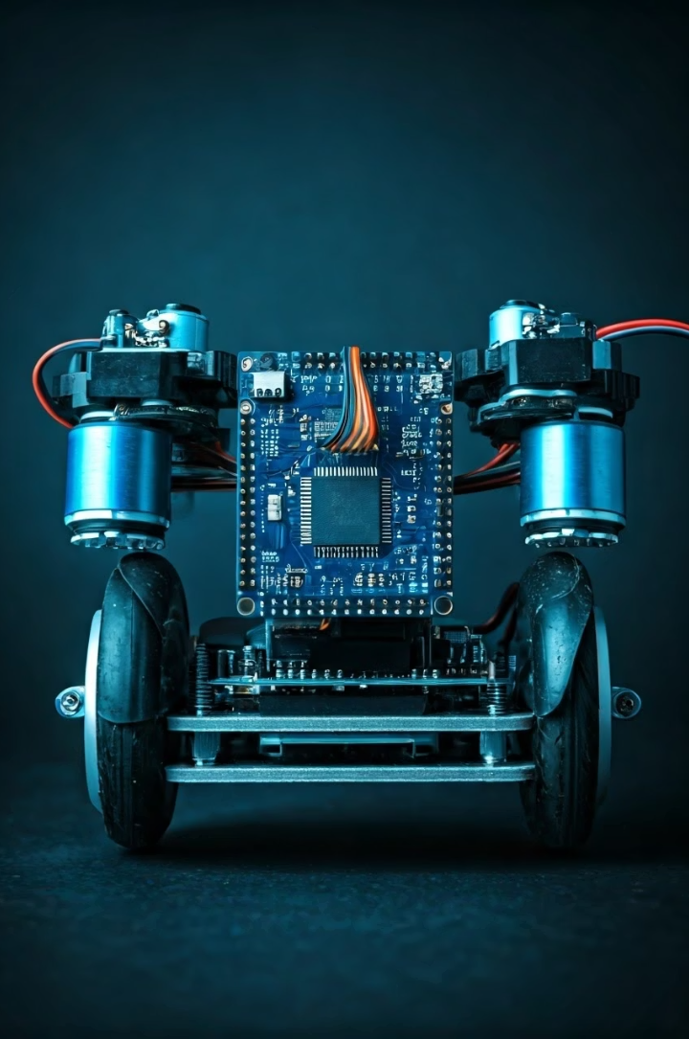




Main Components
Arduino
MPU6050 Sensor
L298D Driver
Processes sensor data and controls motors.
Controls motor direction and speed.
Measures tilt angle and angular velocity.
DC Geared Motors
Drive wheels and maintain balance.

Slide 8
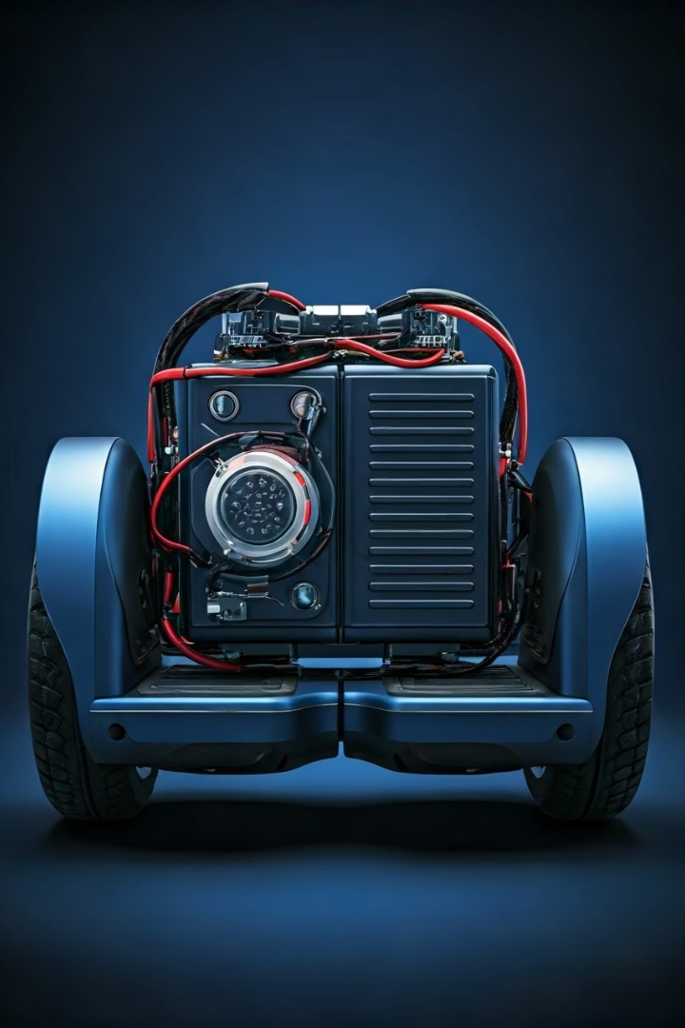



Supporting Components
Battery
Frame
Supplies power to motors and electronics.
Durable structure holding all components together.
Jumper Wires & Switch
Connect components and allow power control.

Slide 9
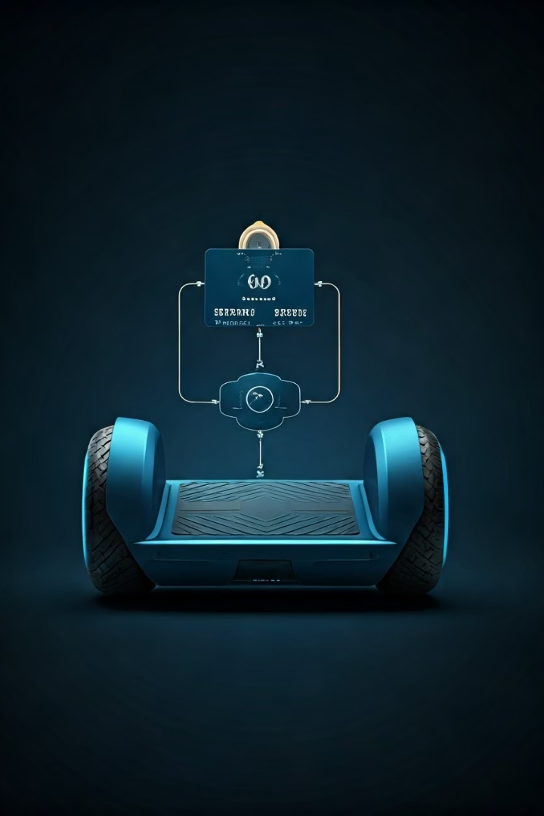




How Balancing Works
Sensing
MPU6050 detects tilt angle and speed.
Calculating
Arduino processes data and calculates correction.
Controlling
Motor driver adjusts motor speed/direction.
Balancing
Motors rotate wheels to restore balance rapidly.

Slide 10
What We Learned
How to use microcontrollers and sensors in a real system.
Sensor Accuracy: MPU6050 provides real-time tilt data for precise control.
Control System: Arduino and motor drivers coordinate to maintain equilibrium.
Prototype Validation: Model closely matches CAD design with thoughtful wiring.
Effective Motor Response: Motors swiftly correct tilt to prevent falls.

